Slide 1
Deep Learning Final Project: Emotion Detection with EEG dataset
Group 8
Sama Samrin

Slide 2
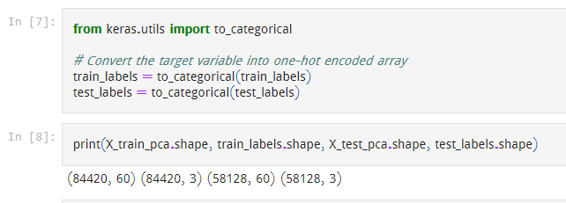
The Dataset: EEG Brain Signal, 2019
Contains extracted differential entropy (DE) features of EEG signals
Training set contains 84,420 data and testing set contains 58,128 data
Each piece of data contains 310 values representing the data of 62 electrodes on 5 frequencies
Ref: https://github.com/PerforMance308/EEG_Dataset

Slide 3
Libraries Used
Keras:
Keras = high-level built-in Python NN library that runs on top of Tensorflow, open-source framework for different DL libraries
Used for building and training models
Numpy:
Used for high-performance linear algebra and array operations
Scikit-learn or Sklearn:
Used for tasks like classification and preprocessing
Pickle:
Used for loading the dataset

Slide 4
Feature Extraction Steps
Applied PCA from the sklearn.decomposition module to perform feature extraction with 60 components
Training and testing data are transformed using the fit_transform() and transform() methods of the PCA object
Converted the target variable to one-hot encoded arrays
Scaled the data to be in the range of 0 to 1 using the MinMaxScaler class of Sklearn

Slide 5
Data Augmentation
Applied to increase the size of the training data and reduce overfitting
Used ImageDataGenerator function from Keras,, which applies random transformations to the data, such as rotation, shifting, shearing, zooming, and flipping
Batch size: Set to 512, which means that the neural network will process 512 samples at a time during training

Slide 6
Data Augmentation (continued)
Augmented training data
Generated by applying the transformations defined in the ImageDataGenerator to the original training data
Combined original and augmented data to create the final training data
Reshaping augmented data
Reshaped the augmented data to match the input shape required by the neural network, which is a 3D tensor with shape (samples, timesteps, channels).
Reshaped the test data is to the same format as well
Final shape after preprocessing
The final shape of the data is (samples, timesteps, channels).
The final shape of the target variable is (samples, classes)

Slide 7

Model Classification
Chosen Learning Model: CNN
Why CNN?: Several research papers including the 2018 publication named “EEG Classification via Convolutional Neural Network-Based Interictal Epileptiform Event Detection” show the success of CNN in classifying EEG data
Ref: Thomas J, Comoretto L, Jin J, Dauwels J, Cash SS, Westover MB. EEG CLassification Via Convolutional Neural Network-Based Interictal Epileptiform Event Detection. Annu Int Conf IEEE Eng Med Biol Soc. 2018 Jul;2018:3148-3151. doi: 10.1109/EMBC.2018.8512930. PMID: 30441062; PMCID: PMC6775768.

Slide 8
Model Classification (continued)
CNN architecture consists of several convolutional and pooling layers, with batch normalization and dropout to reduce overfitting.
Our CNN model architecture: 6 Convolution Layers with 3x3 filters, 3 2x2 Maxpooling Layers etc.
Model compiled with:
Categorical cross-entropy loss function
Adam optimizer with a learning rate of 0.0005
Accuracy as the evaluation metric.
Model trained for 200 epochs. The augmented training data is fed to the model in batches of size 256.

Slide 9
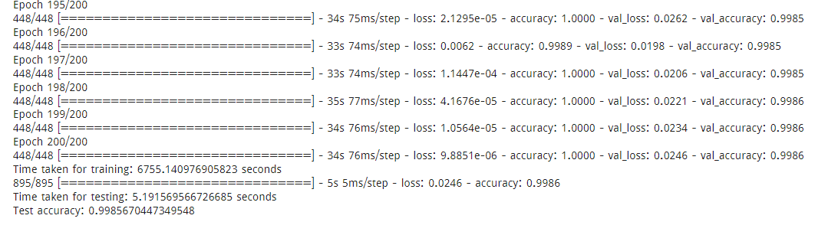
Model Classification (continued)
After training, the model is evaluated on the test data and the test accuracy is printed.

Slide 10
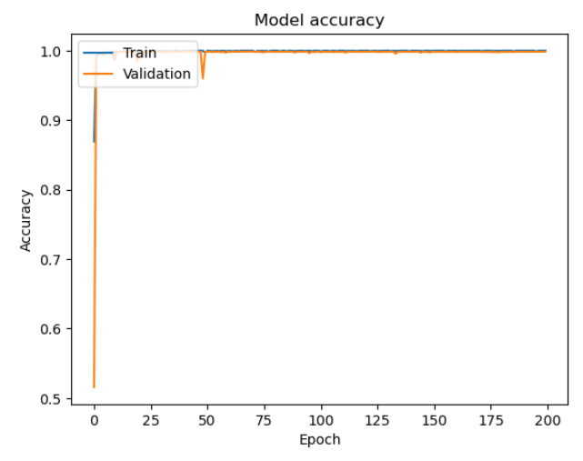
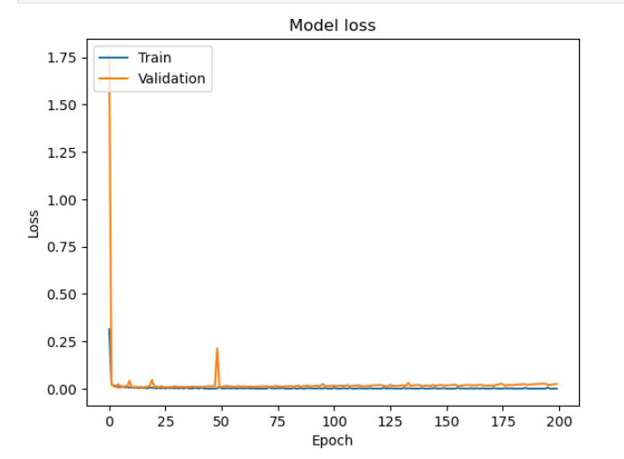
Accuracy and Performance
Evaluating the performance of the trained model on the test data and computing different performance metrics such as accuracy, precision etc
Plotting the accuracy (training and validation) and loss values over epochs using matplotlib

Slide 11
THANK YOU

